Slide 1
Gender and Nationalism

Slide 2
Gender Blindness in Nationalism
Nationalism: ‘it is hard to think of any political phenomenon which remains so puzzling and about which there is less analytic consensus’ (Anderson 1996 in Mapping the Nation).
Literature on nationalism has not been interested in questions of gender or the differential participation of women and men.

Slide 3
The political doctrine of nationalism is based on the idea of a nation or a people, and it usually locates an ‘‘other’’ who is used to reinforce ties uniting the nation. In other words, a coherent community exists because ‘‘we’’ are ethnically, linguistically, religiously, and/or ideologically distinct from ‘‘them.’’ (Banerjee: 2003)

Slide 4
It has not been until the emergence of feminist analysis that the gendered nature of imagined political identities has been uncovered and deconstructed (Blom, Hall, & Hagemann, 2000; Enloe, 1983, 2000; Mayar, 1999; McClintock, 1995; McClintock, Mufti, & Shohat, 1997; Yuval-Davis & Anthias, 1989).

Slide 5
But how is gender connected to a formation of various nationalism?
Usually a nationalism is gendered in that it draws on socially constructed ideas of masculinity and femininity to shape female and male participation in nation building, as well as the manner in which the nation is embodied in the imagination of self-professed nationalists. (Banerjee: 2003)

Slide 6
Women are employed as social reproducers of cultural forms and teach children rituals and myths aimed at locating them within a specific national context
Motherland or nation is a common metaphor to invoke nationalism indicating a woman who needs to be protected by male warriors.

Slide 7
Feminist Approaches to Nationalism
‘[A]ll nationalisms are gendered; all are invented; and all are dangerous… in the sense that they represent relations to political power and to the technologies of violence’ (McClintock 1997).

Slide 8
Gender and the idea of nationhood:
The nation is frequently figured as a woman and women are constructed as bearers of the nation.

Slide 9
Many Indian nationalists vow to protect Bharatmata or ‘‘Mother India.’’
Nation as woman also intersects the nationalist discourse through socially constructed ideas of honor. In many contexts, women symbolize national honor, thus any act (e.g., rape) that defiles and violates women’s bodies becomes a political weapon aimed at destroying the enemy nation’s honor. (Banerjee: 2003)

Slide 10
Reproduction is highly significant to nationalist movements and identity constructions; reproduction is politicised and motherhood militarised: ‘demographic race’.
Example: In former Yugoslavia wars, constructions of ethno-national identity intersected with restrictive constructions of gender identity placing a high value on female chastity and nationalist motherhood, whilst framing masculinity as equal to warrior aggression.

Slide 12
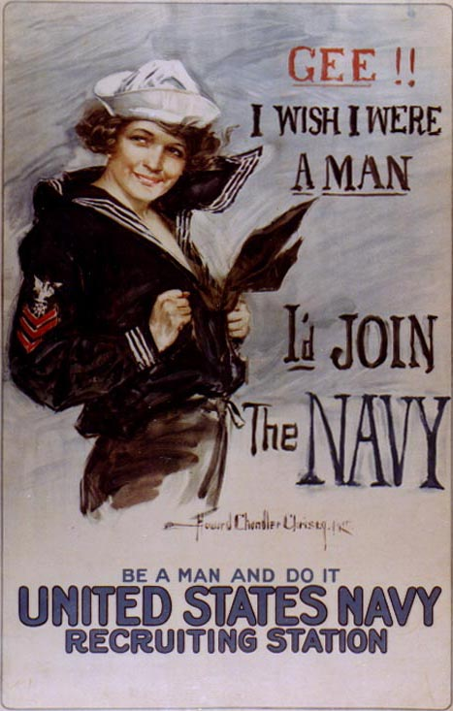
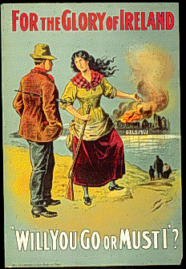
WWI recruitment posters

Slide 13
Women’s Participation in Nationalist Movements
Virginia Woolf: ‘as a woman I have no country. As a woman I want no country. As a woman my country is the whole world’ (1938 Three Guineas).

Slide 14
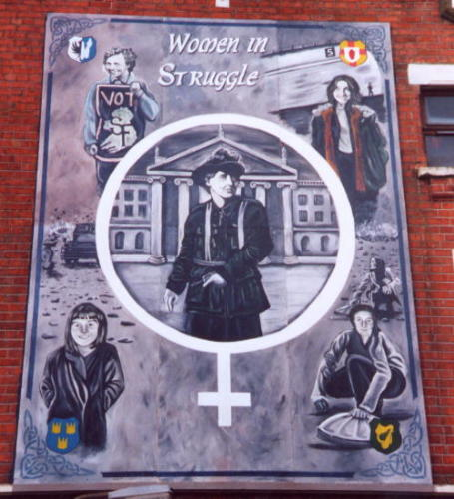
Northern Ireland: women’s nationalist activism

Slide 15
Woman question’ central part of many anti-colonial nationalist struggles; greater freedoms for women = modernity and civilisation. J S Mill: ‘the condition of women is one of the most remarkable circumstances in the manner of nations.

Slide 16
Jayawardena (1986): in most Asian anti-colonial nationalist movements in 19th/early 20th centuries struggles for women’s emancipation were integral. Advances in women’s legal and political equality in Asia but didn’t achieve change in patriarchal structures of family and society.

Slide 17
Women’s participation in nationalist movements (even as soldiers) has never guaranteed greater rights and freedoms in a new political/ territorial structure.
Example: formation of independent Ireland (e.g. 1937 Constitution).
‘Women might have had a place in the revolution, but for Ireland’s new rulers, aping their imperial masters in this as in so many things, they certainly had no place in government’ (Coulter: 1993).

